Slide 1
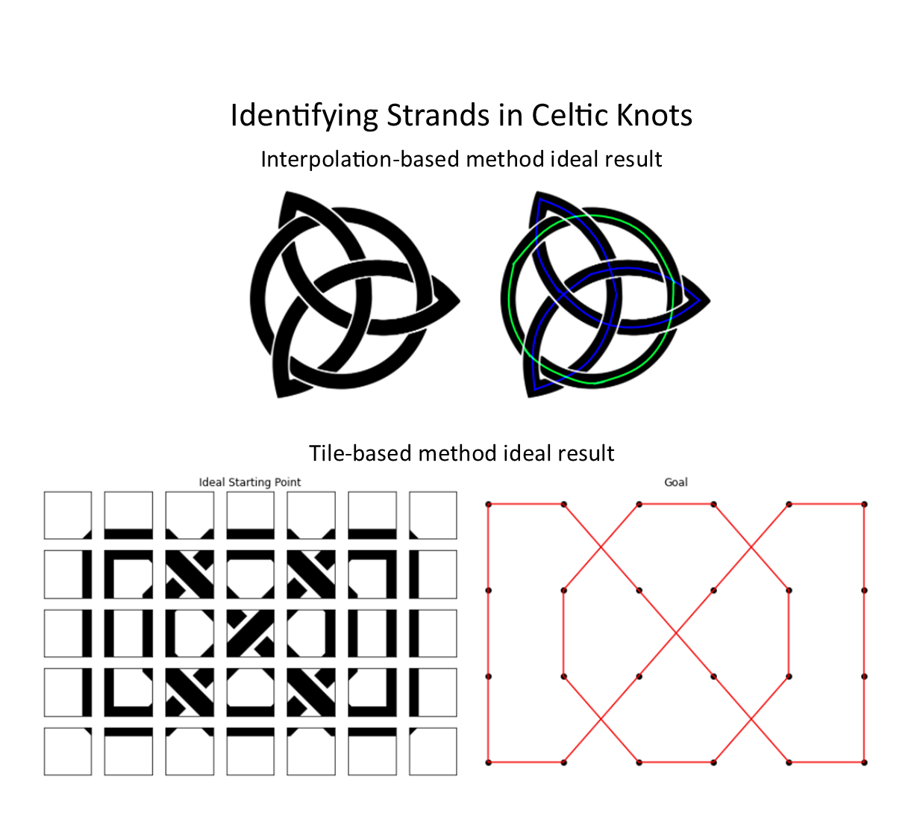
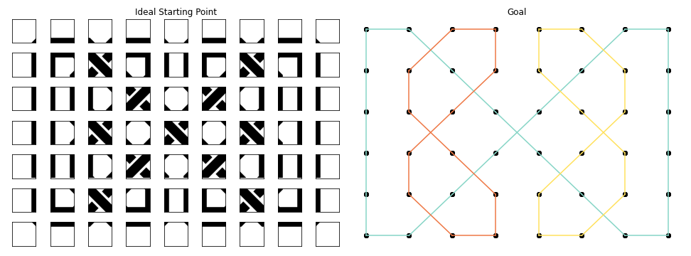



Identifying Strands in Celtic Knots
Interpolation-based method ideal result
Tile-based method ideal result
CS 4476 Fall 2020
Collin Avidano
Claudia Chu
Evan Strat
Jack Wolfard
Notes:
Hello, our group project is about identifying strands in Celtic Knots. Celtic knots are decorative images consisting of “strands” that intertwine with each other. There are already several programs that can generate these knots, but very little research on the structural analysis of existing celtic knot images.

Slide 2
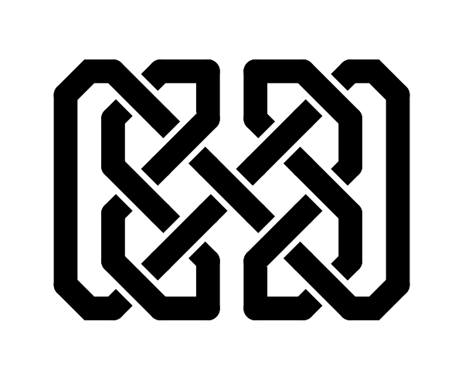
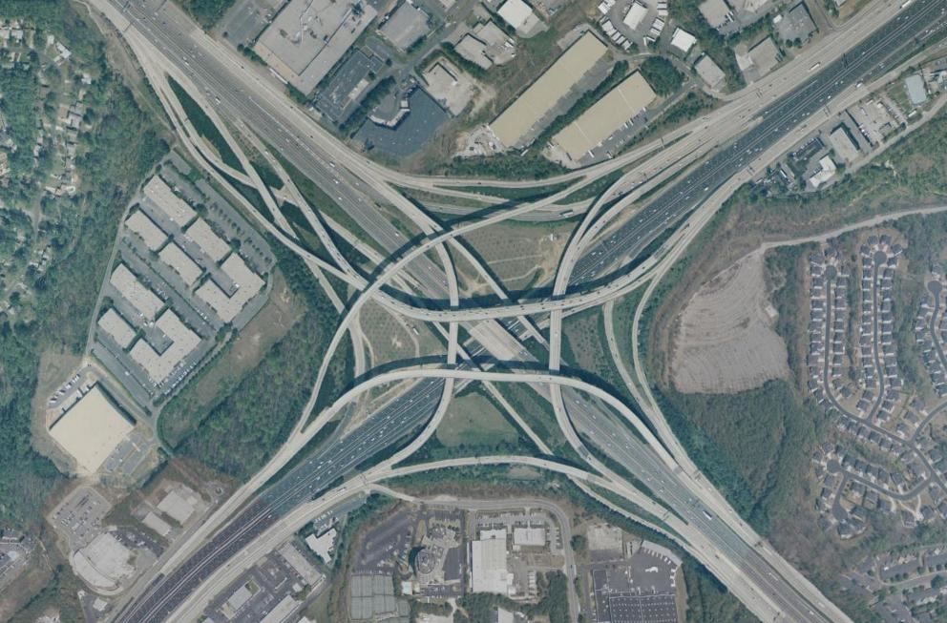
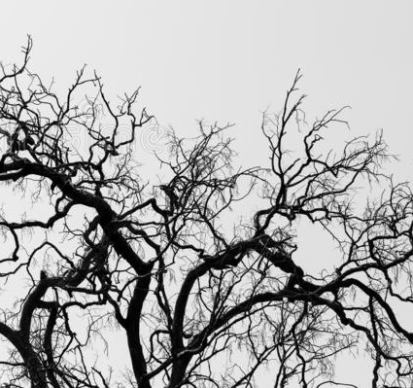
Motivation
Example of Occlusion
Two methods
Notes:
Developing methods to determine the structure of celtic knots may reveal ways to resolve occlusion, which can be applied to many real analysis tasks of other objects in nature.
For our project, we explored two different approaches to analyze the structure of celtic knots.

Slide 3
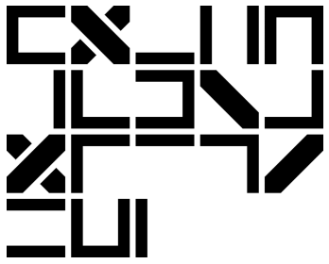
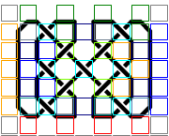
Tile-Based Approach
Notes:
First, the tile-based approach. Many celtic knots can be generated by using a library of different tile types. We apply template matching to determine which tile types align where, and further extrapolate the overall structure of the knot.

Slide 4
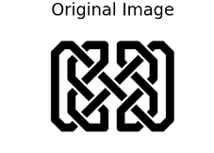

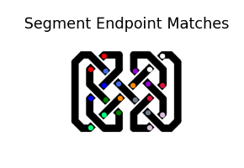
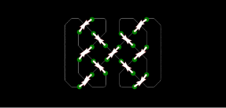
Interpolation Approach
Notes:
Second, the interpolation approach. This finds the end points for each curve, and then connects them so we have continuous strands.

Slide 5

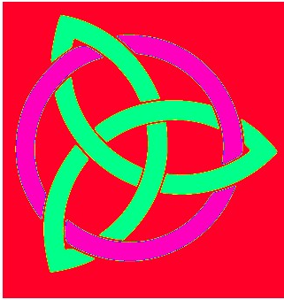
Results
Github repo: https://github.gatech.edu/cv-project
Website: cv-project/website/index.html
Notes:
In the end, both approaches can identify the independent strands in a celtic knot and other features. If you’d like to learn more, check out our github repository.

